Slide 1
Unit 6: Time Series
Non-Stationary Models
Signal + Noise
ARIMA
ARUMA

Slide 2
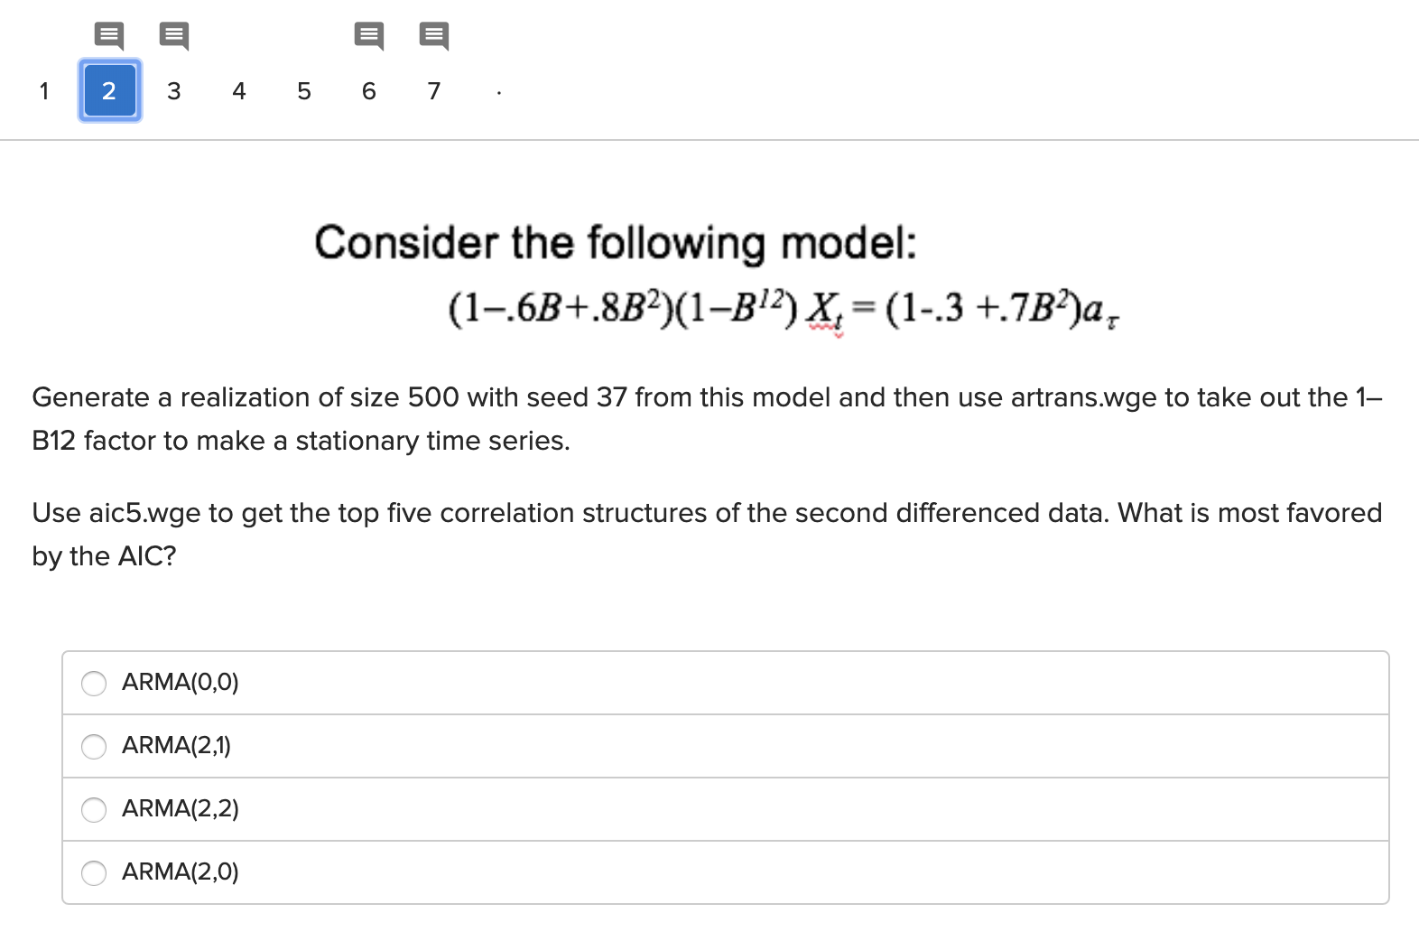
Concept Check … Checks

Slide 3
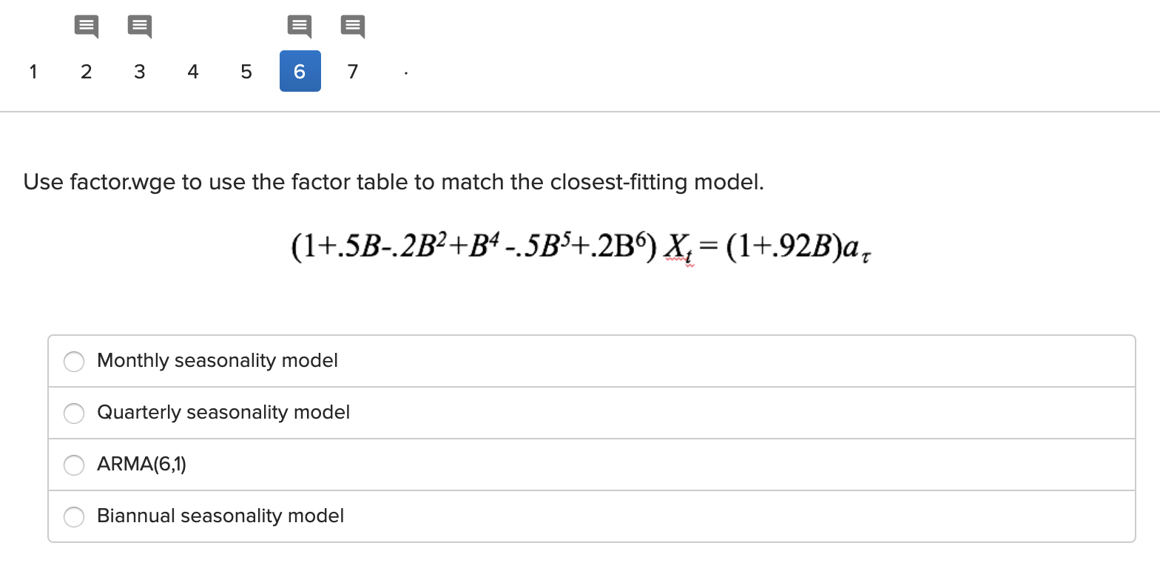
Concept Check … Check
s = 12 (common with Monthly Data.)
s = 4 common with Quarterly Data.
s = 2 (common with data collected semi -annually.)

Slide 4
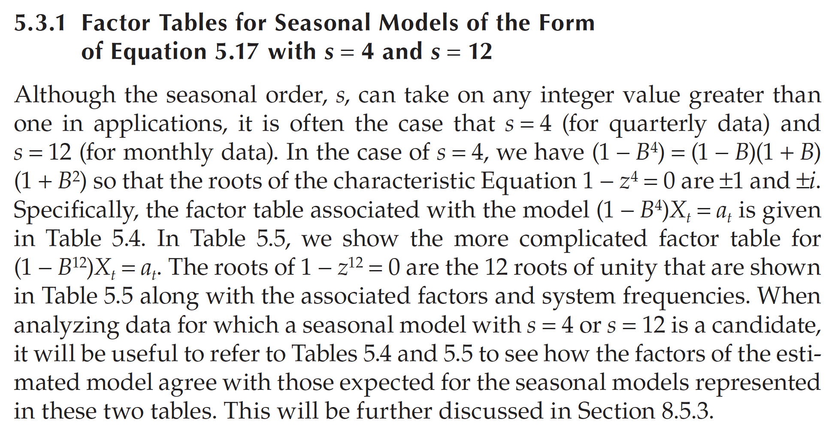
Quarterly Data / Monthly Data Page 218

Slide 5
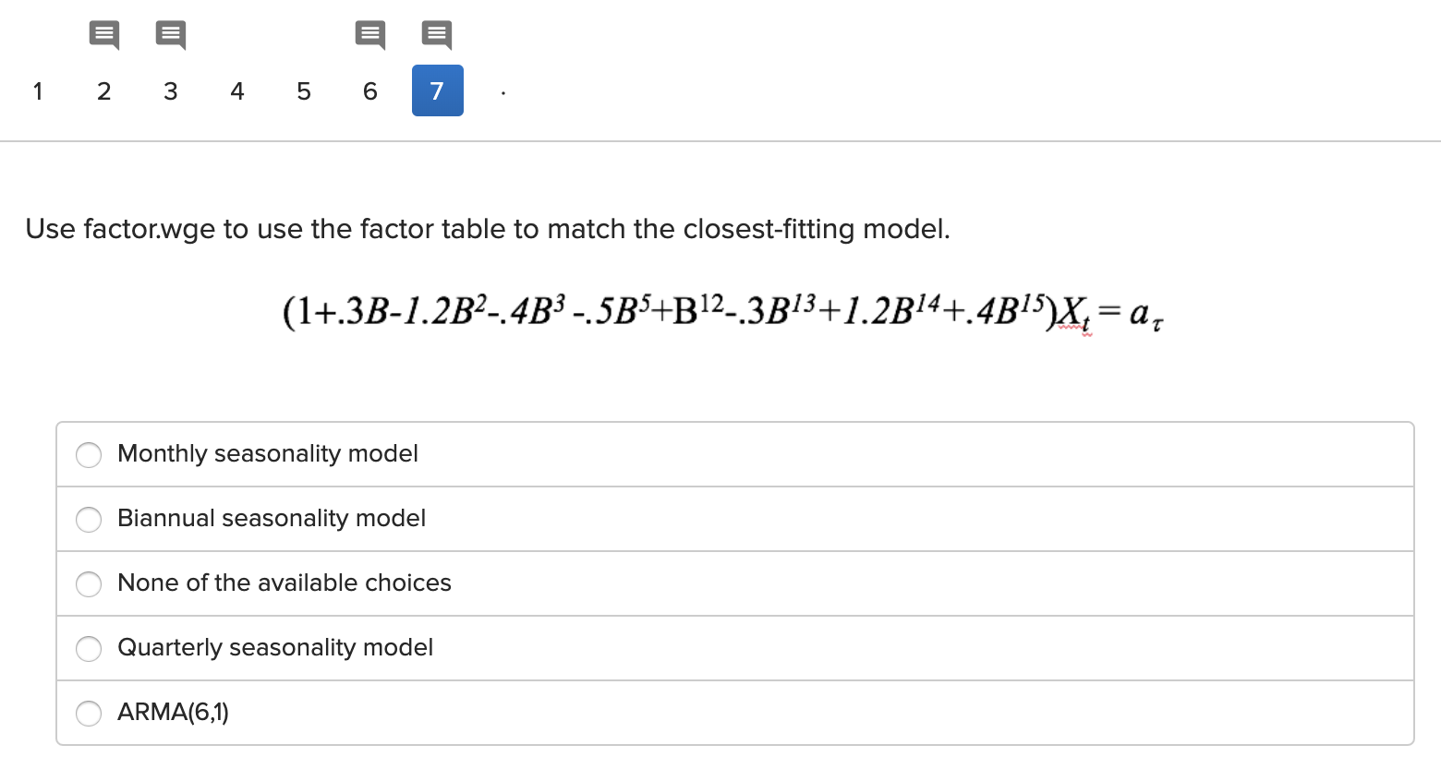
Concept Check … Check
s = 12 (common with Monthly Data.)
s = 2 (common with data collected semi -annually.)
s = 4 common with Quarterly Data.

Slide 6
A Different Order 15 Model
Consider the following model below and investigate if it is similar to model with s ≠ 0. If so, which s seems most appropriate.
(-0.6996B -0.2599B² - 0.0079B³ + 0.0646B⁴ - 0.1381B⁵ + 0.0953B⁶ -0.0235B⁷ + 0.0969B⁸ -0.1770B⁹ +0.1191B¹⁰ -0.1030B¹¹ ⁻ 0.7754B¹² + 0.4590B¹³ + 0.4099B¹⁴ -0.0501B¹⁵)X_{t}=a_{t}
factor.wge(c(0.6996, 0.2599, 0.0079, -0.0646, 0.1381, -0.0953, 0.0235, -0.0969, 0.1770, -0.1191, 0.1030, 0.7754, -0.4590, -0.4099, 0.0501))

Slide 7
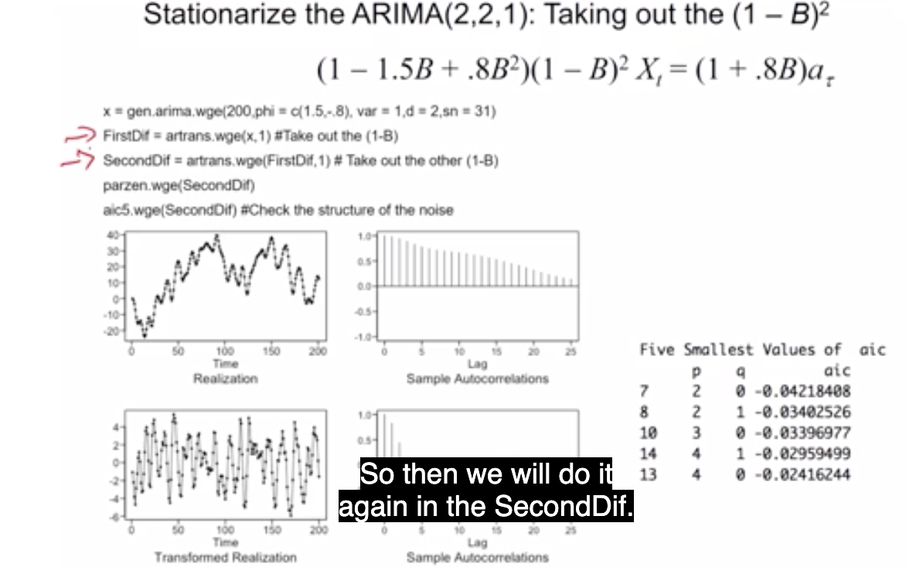
Try It Out!
Generate the data as it should be generated and then see which models the AIC favors.

Slide 8
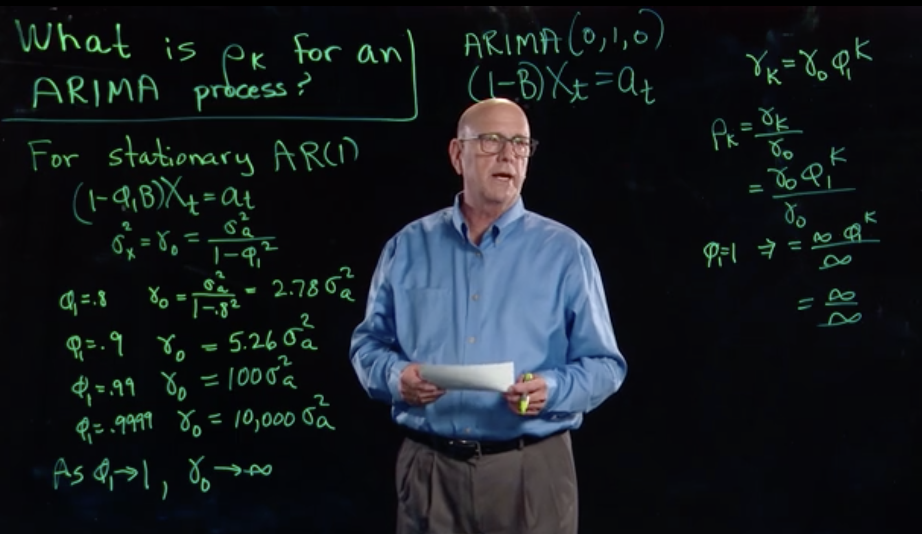

$$σ_{x}^{2} v.σ_{a}^{2}$$

Slide 9
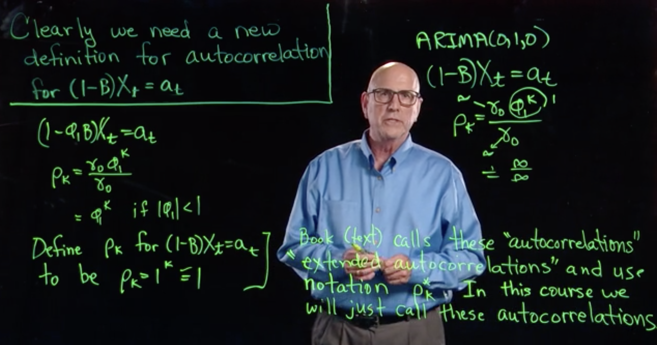
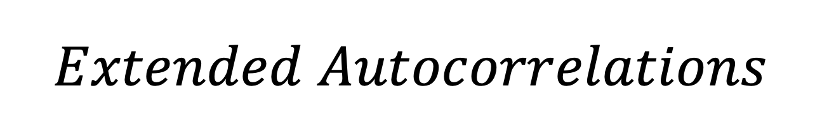
$$Extended Autocorrelations$$

Slide 10
Break Out 1

Slide 11
Break Out 1
For each person in your group:
Remind everyone of your realization
Defend why you thought a signal + noise, ARIMA, ARUMA, ARMA, or any other model was appropriate or not appropriate.

Slide 12
End Break Out 1

Slide 13
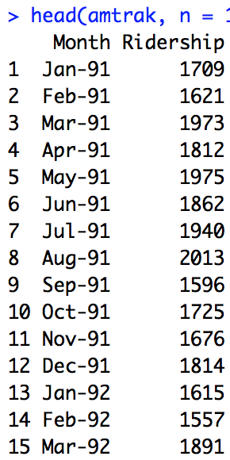
Monthly Amtrak Data

Slide 14
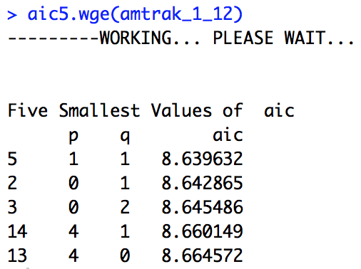
Monthly Amtrak Data
Given the several peaks in the spectral density and the intuitive presence of at least annual seasonality, the (1-B^12) factor was removed. At that point there was still significant wandering and some evidence of a (1-B) term in the acf therefore the (1-B) was taken out as well. At this point the realization looked stationary and the aic5.wge() favored the ARMA(1,1). For this reason, a reasonable model seemed to be the an ARUMA model with d = 1, s = 12, p = 1 and q = 1. This can be written as a ARIMA(1,1,1) with s = 12.

Slide 15
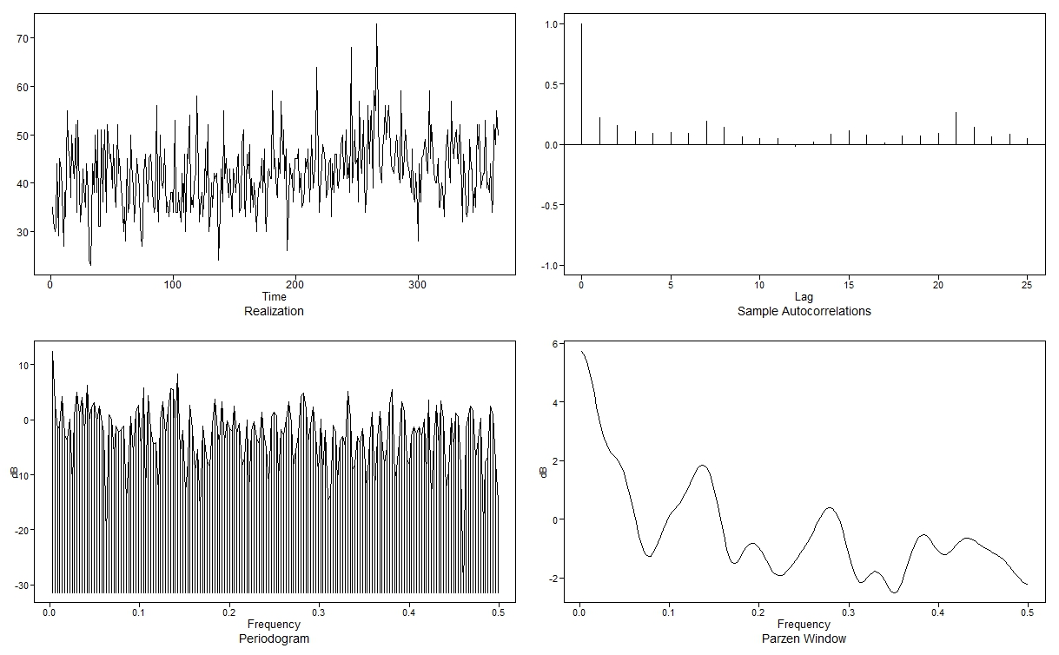
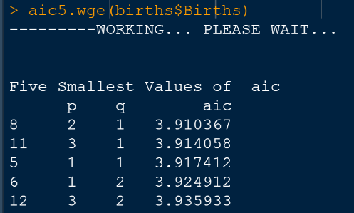
Week 6 Assignment – Female Births in 1959 Dataset
The autocorrelation shows oscillation or cyclic behavior, but not at regular intervals.
The spectral density peaks at 0.0, but also has several smaller peaks
I’m not sure what model would be best. The AIC5 suggests an ARMA(2,1)

Slide 16
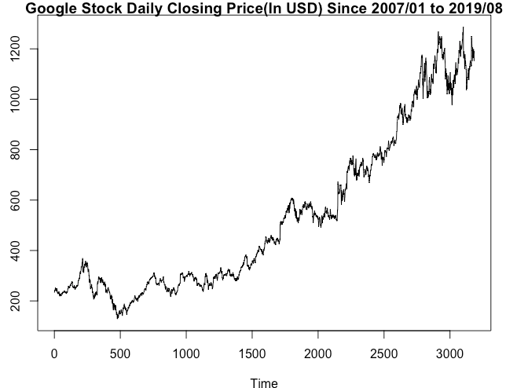
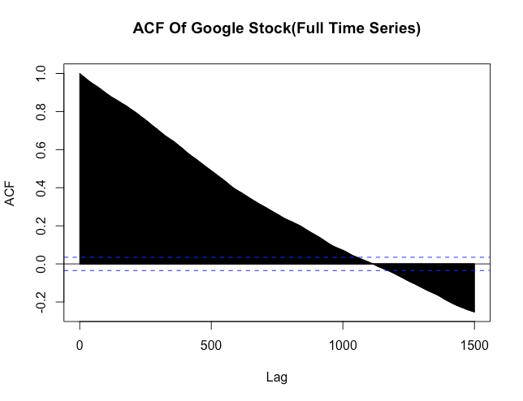
Looking at your time series from the first day of class, you addressed its stationarity before. Does either a signal plus noise, ARIMA, or ARUMA (seasonal) model seem appropriate?
Looking at realization and its correlation structure, which exhibits a very slowly damping structure with near value 1 correlation between large number of initial lags, it appears ARIMA model would be appropriate. Although it is counterintuitive to assume there might be a trend component in stock data, there is ever so slight possibility of trend component( liner or quadratic) in the realization in short term and hence signal plus noise model also appears to be appropriate. Now, since this stock is of Google, a tech company, with no particular product launch dates, it is counterintuitive to assume that its stock would be having some seasonal components. Moreover, autocorrelation plot doesn’t indicate any high correlation among monthly, quarterly, yearly etc lags ie no seasonal correlation structure. Hence, ARUMA(Seasonal) model might not be appropriate to model this stock data.

Slide 17
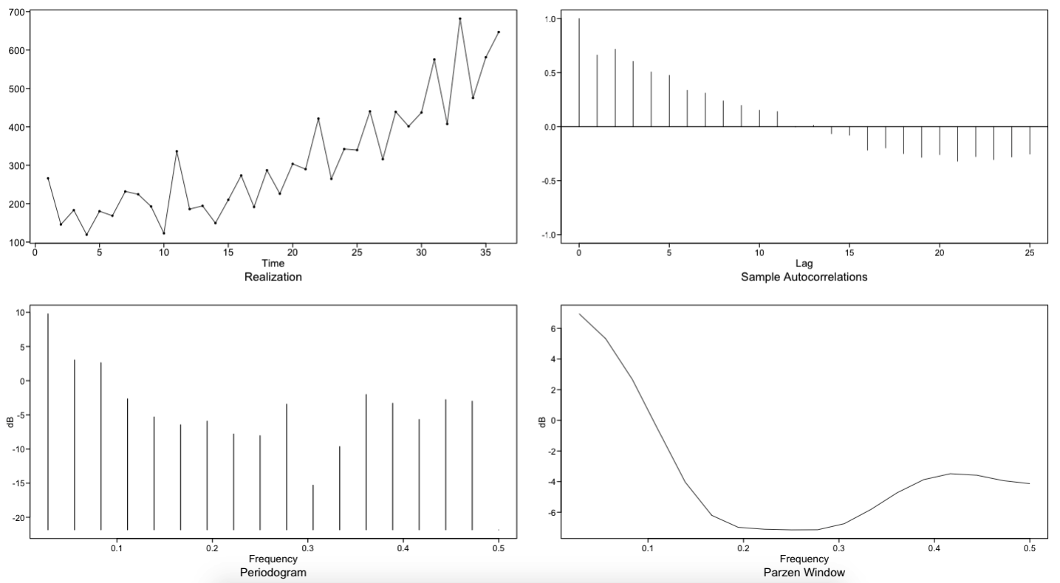
6.9.1: Assessing Shampoo Models
ARUMA wouldn’t make much sense since no ”spikes” can be seen in the ACF plot at some regular interval
ARIMA may work
Signal plus noise modeling might be best:
Signal = parabolic trend
Noise = remaining variation

Slide 18
Break Out 2

Slide 19
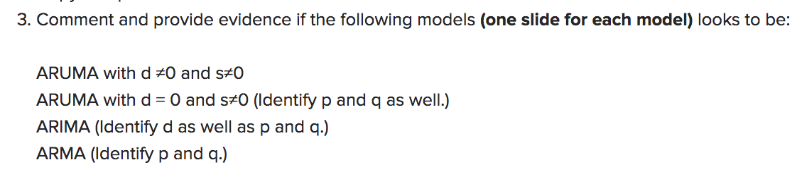
Break Out 2

Slide 20
(1−B⁴) X_{t} = (1+.3B) (1−.6B+.8B²)a_{τ}

Slide 21
(1−B⁴) X_{t} = (1+.3B) (1−.6B+.8B²)a_{τ}
ARIMA(0,0,3) with s = 4

Slide 22
b. (1+.3B) X_{t} = (1−.6B+.8B²) a_{τ}

Slide 23
b. (1+.3B) X_{t} = (1−.6B+.8B²) a_{τ}
ARIMA(1,0,2)

Slide 24
(1−.1B-.99B² +.013B³ +.2078B⁴ +.0888B⁵ +.00864B⁶)(1−B)²(1−B¹²) X_{t} = (1−.6B+.8B²)a_{τ}

Slide 25
(1−.1B-.99B² +.013B³ +.2078B⁴ +.0888B⁵ +.00864B⁶)(1−B)²(1−B¹²) X_{t} = (1−.6B+.8B²)a_{τ}
ARIMA(6,2,2) with s = 12

Slide 26
Here are some more! Try’em out!

Slide 27
(1−.8B)(1−B)X_{t} = a_{t}

Slide 28
(1−.8B)(1−B)X_{t} = a_{t}
ARIMA(1,1,0)

Slide 29
(1−.4B)(1−B)X_{t} = (1−.85B)a_{t}

Slide 30
(1−.4B)(1−B)X_{t} = (1−.85B)a_{t}
ARIMA(1,1,1)

Slide 31
(1−.4B)(1−B)(1−B⁴)X_{t} = (1−.85B)a_{t}

Slide 32
(1−.4B)(1−B)(1−B⁴)X_{t} = (1−.85B)a_{t}
ARIMA(1,1,1) with s = 4

Slide 33
(1−.4B-.74B³)(1−.6B)(1−B)²(1−B¹²)X_{t} = (1−.85B²)a_{t}

Slide 34
(1−.4B-.74B³)(1−.6B)(1−B)²(1−B¹²)X_{t} = (1−.85B²)a_{t}
ARIMA(4,2,2) with s = 12

Slide 35
Simply Judge From These Plots

Slide 36
Simply Judge From These Plots
ata = gen.aruma.wge(500,d = 1, s = 12, phi = -.7, theta = -.9, sn = 9)

Slide 37
Simply Judge From The Plots Just Speculate

Slide 38
Simply Judge From The Plots Just Speculate
data = gen.aruma.wge(500,d = 2, phi = -.7, theta = -.9, sn = 9)

Slide 39
End Break Out 2

Slide 40
Break Out 3

Slide 41
Stock Modeling
For each member of your group
Describe the stock you picked
Describe the analysis you performed to try and identify a model.

Slide 42
End Break Out 3

Slide 43
https://www.wsj.com/articles/sohn-stock-tips-may-not-be-worth-peanuts-1524592131

Slide 44
MO
getSymbols("MO", from = "2018-6-10", to = "2019-6-10", auto.assign = TRUE)
plotts.sample.wge(MO$MO.Close)
MO1 = artrans.wge(MO$MO.Close,1)

Slide 45
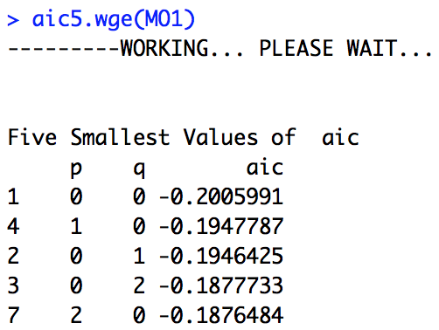
MO
MO1 = artrans.wge(MO$MO.Close,1)

Slide 46
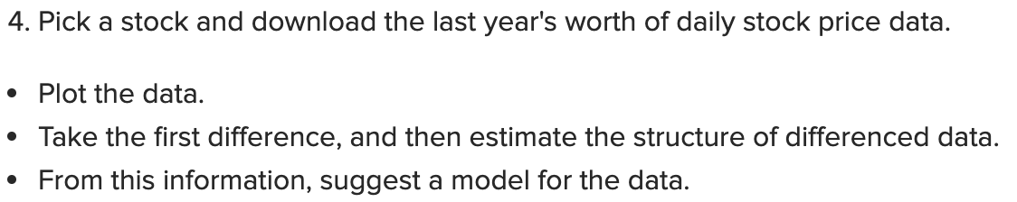
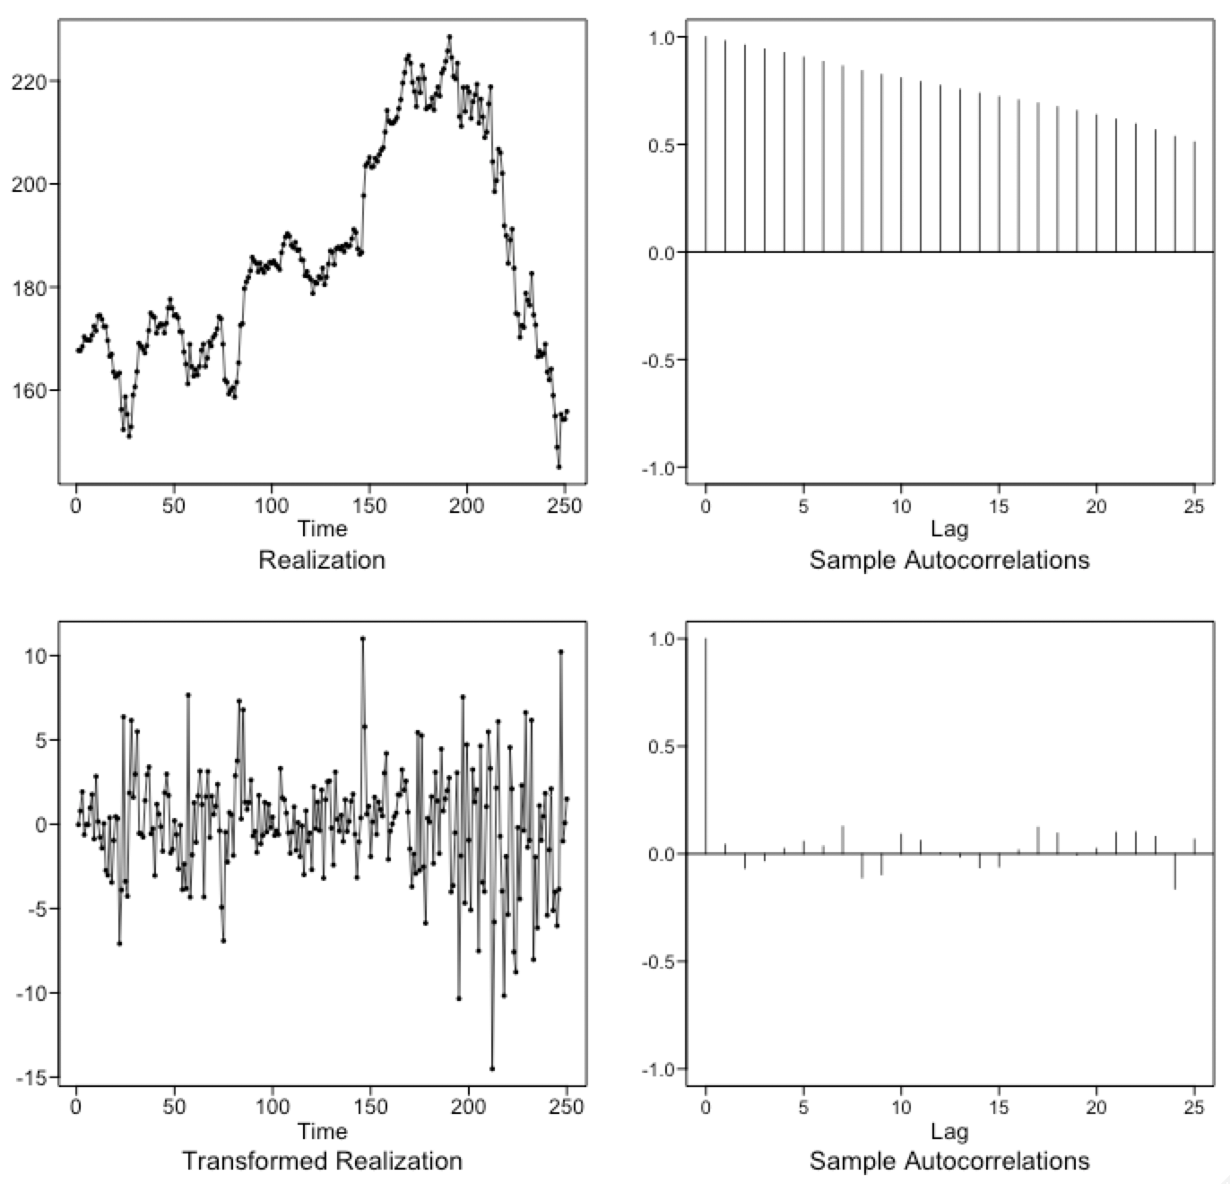
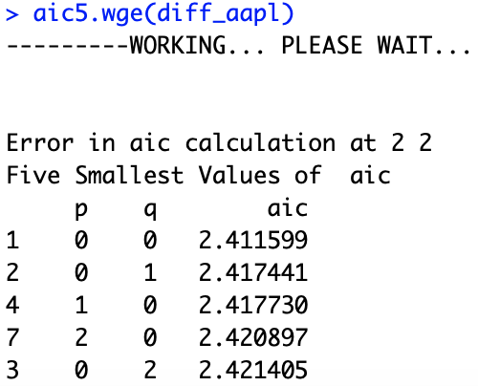
For Live Session
Apple Inc. Daily Adjusted Close Price from 2018
The differenced data suggests white noise. The use of aic5.wge() confirms it.
The stock data will be best fit with a signal plus noise model.

Slide 47
Break Out 4

Slide 48
Break Out 4
Identify the seasonality if any:
(1−.76B - .94B⁴ +.75B⁵)X_{t} = a_{t}

Slide 49
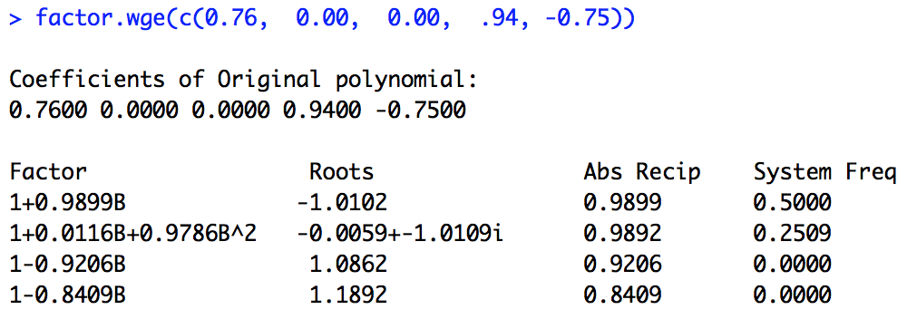
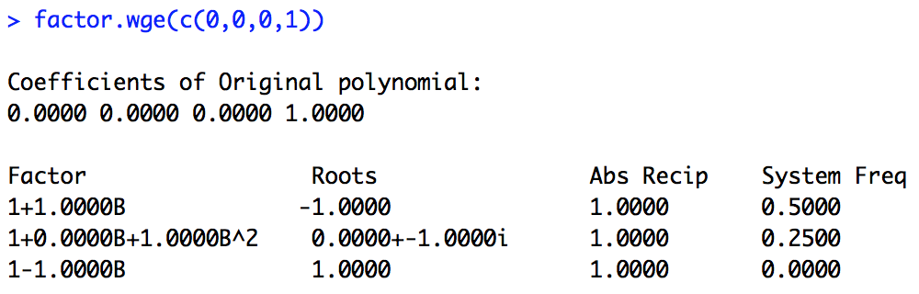
Break Out 4
Identify the seasonality if any:
(1−.76B - .94B⁴ +.75B⁵)X_{t} = a_{t}
factor.wge(c(0.76, 0.00, 0.00, .94, -0.75))

Slide 50
Break Out 4
Identify the seasonality if any:
(1−.76B - .94B⁴ +.75B⁵)X_{t} = a_{t}

Slide 51
Break Out 4
Identify the seasonality if any:
(1−.76B - .94B⁴ +.75B⁵)X_{t} = a_{t}
factor.wge(c(0.76, 0.00, 0.00, .94, -0.75))

Slide 52
Which Model has most evidence of s = 12
Model 1
(-0.1B - 0.72B² + 0.016B³ + 0.29B⁴ - 0.02B⁵ - 0.144B⁶ + 0.0032B⁷ - 0.0621B⁸ + 0.008B⁹ + 0.058B¹⁰ - 0.00128B¹¹ - 0.0072B¹²)Xt = at
# This will help:
c(0.1, 0.72, -0.016, -0.29, 0.02, 0.144, -0.0032, 0.0621, -0.008, -0.058, 0.00128, 0.0072)
Model 2
(.2B + 0.63B² - 0.97B¹² - 0.1940B¹³ + 0.6111B¹⁴)Xt = at
# This will help:
c(-0.2000, 0.6300, 0.0000, 0.0000, 0.0000, 0.0000, 0.0000, 0.0000, 0.0000, 0.0000, 0.0000, 0.9700, 0.1940, -0.6111)

Slide 53
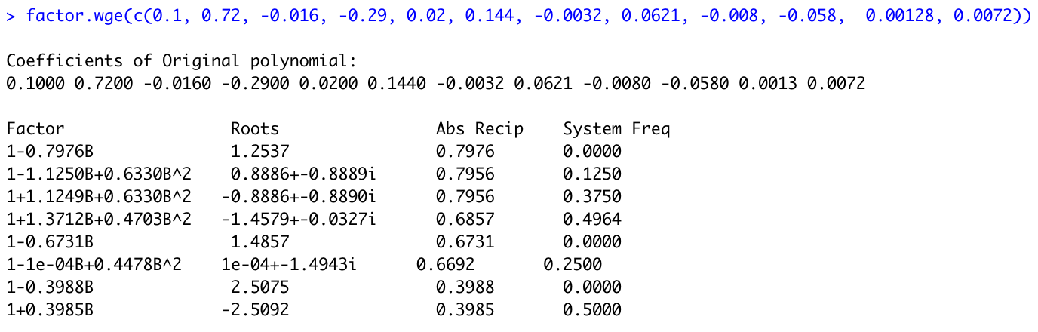
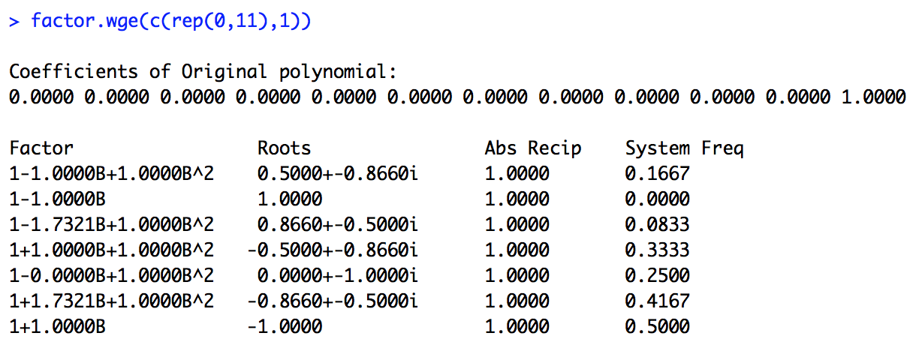
Which Model has most evidence of s = 12
Model 1
(-0.1B - 0.72B² + 0.016B³ + 0.29B⁴ - 0.02B⁵ - 0.144B⁶ + 0.0032B⁷ - 0.0621B⁸ + 0.008B⁹ + 0.058B¹⁰ - 0.00128B¹¹ - 0.0072B¹²)Xt = at
# This will help:
c(0.1, 0.72, -0.016, -0.29, 0.02, 0.144, -0.0032, 0.0621, -0.008, -0.058, 0.00128, 0.0072)

Slide 54
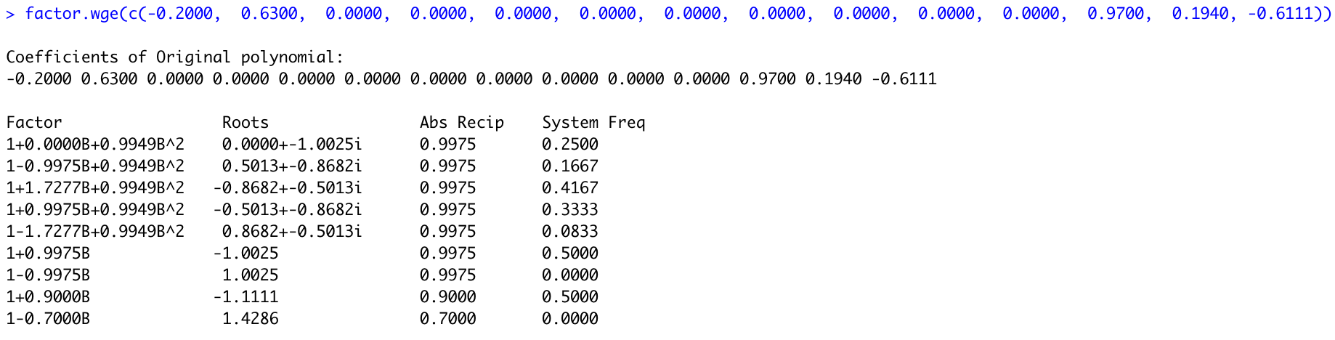
Which Model has most evidence of s = 12
Model 2
factor.wge(c(-0.2000, 0.6300, 0.0000, 0.0000, 0.0000, 0.0000, 0.0000, 0.0000, 0.0000, 0.0000, 0.0000, 0.9700, 0.1940, -0.6111))

Slide 55
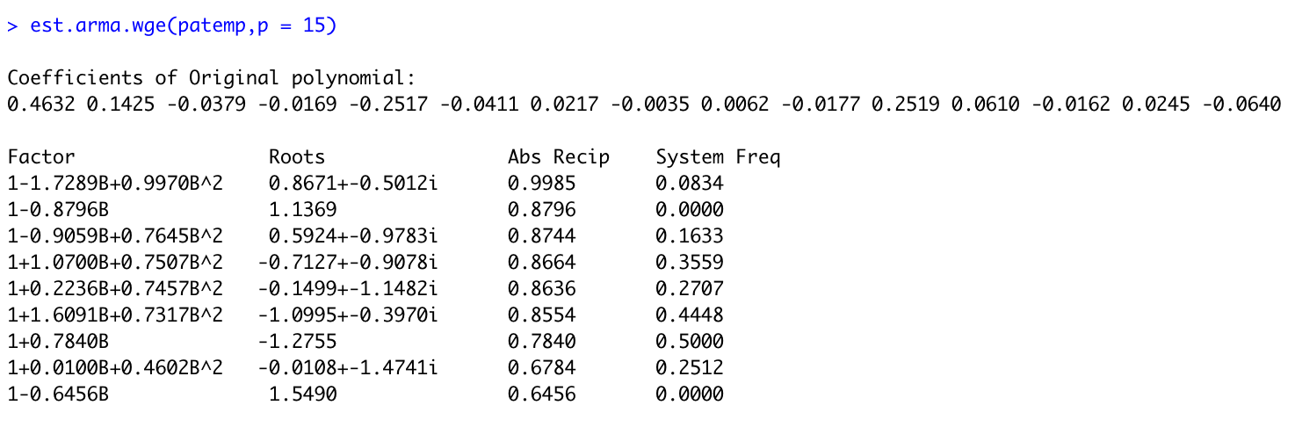
Pennsylvania Temperature Data
This is a an AR(15) that was fit to the Penn. Temperature data.
What do you think about a (1 – B¹²)?

Slide 56
End Break Out 4

Slide 57
Nyquist Frequency Discussion
#Nyquist Frequency
## Data Generation
We have generated data that has a frequency on the scale of seconds of .02. That is, the data have a period of 50 seconds.
We have then sampled only at every minute (every 60th observation). Note that this has a frequency around .2.
```{r}
library(tswge)
P02 = gen.sigplusnoise.wge(6000,coef = c(1,0), freq = c(.02,0), vara = 0)
parzen.wge(P02)
x = seq(1,6000, by = 60)
Min = P02[x]
parzen.wge(Min)
par(mfrow=c(1,2))
parzen.wge(P02)
parzen.wge(Min)
```
## Scenario
Consider now that the data we observed first was the data observed at every minute. We would then see a frequency of about .2.
```{r}
parzen.wge(Min)
```
However, there was another frequency present but we could not observe it ... unless we sample faster.
The P02 data is the data that was then recorded at the seconds. Each 60th data point is the same as the Minute data ... but there is a much different frequency present now. Now each integer represents a second.
```{r}
parzen.wge(P02)
```

